Slide 1




Project name:
EdChain Innovators
Project description:
Using blockchain to streamline and secure academic credential verification.
Team members:
Eskandar Atrakchi x23137517
AI Hackathon, School of Computing, National College of Ireland

Slide 2

Experienced and Passionate Team Leading the Way
Eskandar Atrakchi, Student & co-founder of Avanzo, Real estate blockchain development

Slide 3
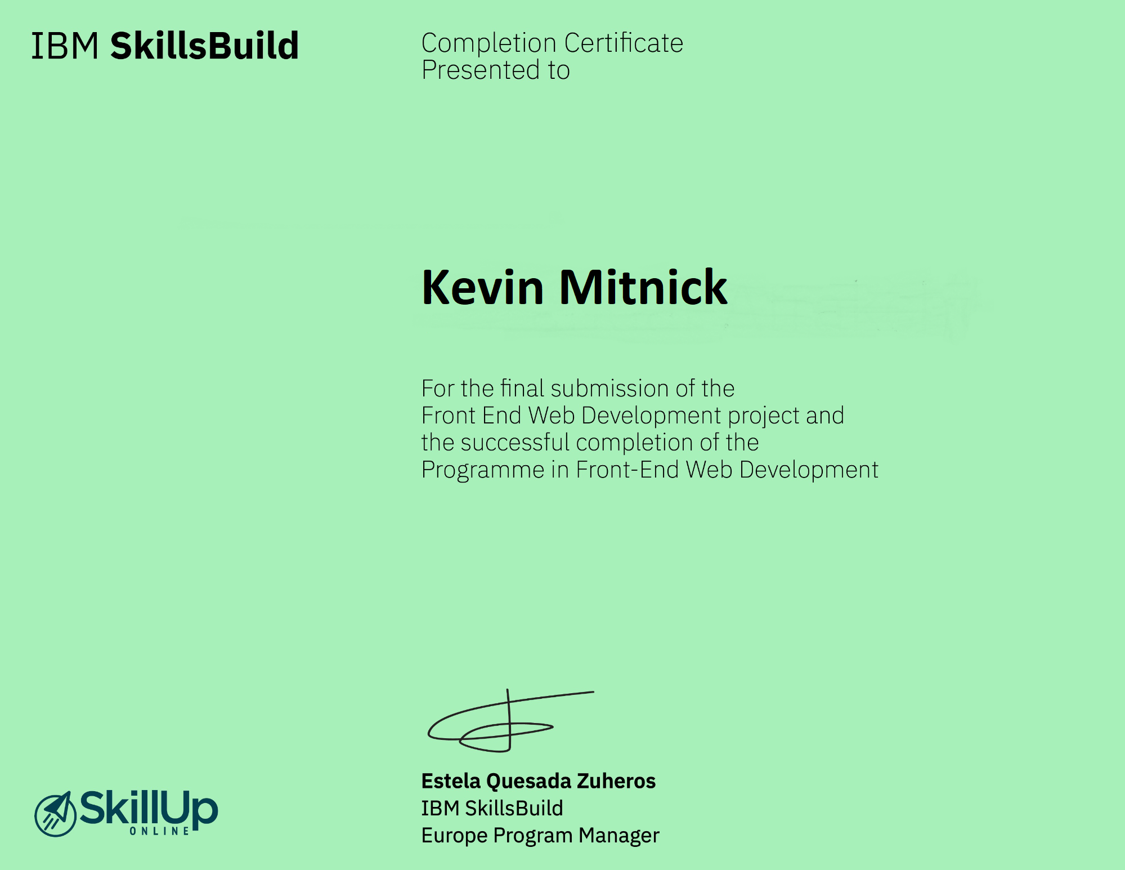

Slide 4
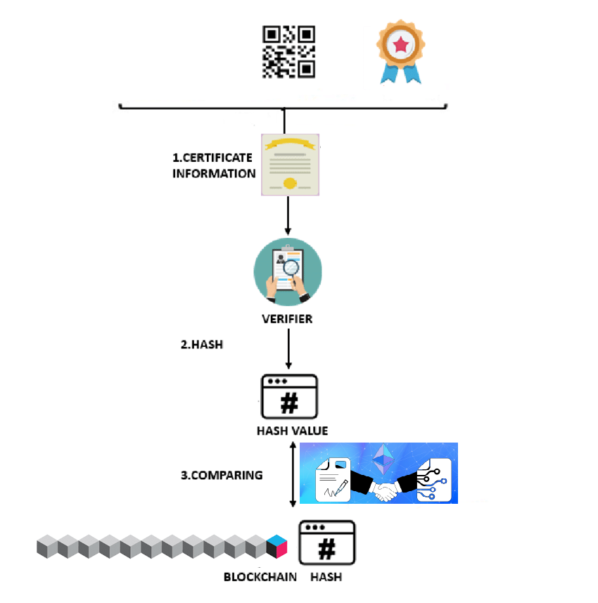

The hash value of the certificate
Smart contracts automate verification, eliminating manual checks and human error.
The certificate block
The hash value is found in the blockchain

Slide 5



Is It Feasible?
The core technology behind EdChain Innovators, blockchain, is well-established and proven in various industries.
Experienced development team with a clear understanding of the technical challenges and potential solutions.
Growing demand for secure and efficient credential verification methods across the education sector.
Notes:
Is it feasible and is there a market for it?
Planning and Projections – Has the market been researched & competitors identified?
How quickly can it be commercialised?
Does the project have export potential?

Slide 6
Financing
Cost Breakdown
Development (SCs)
Operations
Integration
Funding Strategies
Grant funding
Venture Capital
Token-based incentive system
Revenue Model
Subscription fees
Transaction fees
Notes:
Cost Breakdown:
Development: Costs associated with building the blockchain infrastructure, smart contracts, and user interface.
Operations: Ongoing expenses for maintaining the platform, including server costs, personnel, and marketing.
Integration: Facilitating seamless integration with existing educational databases and systems.
Funding Strategies:
Bootstrapping: Utilizing personal funds or resources from the founding team to initiate development.
Grant funding: Seeking financial support from government agencies or educational institutions interested in fostering innovation in the education sector.
Venture Capital: Partnering with venture capital firms interested in investing in high-growth blockchain startups.
Token-based incentive system: Implementing a tokenized reward system to incentivize participation and adoption from educational institutions and individuals within the CryptoScholar network.
Revenue Model:
Subscription fees: Educational institutions may pay annual or monthly subscription fees for access to the platform's verification services.
Transaction fees: A small fee might be charged for each credential verification request initiated on the platform.

Slide 7





Marketing Plan
Enhanced security
Increased efficiency
Improved transparency
Greater control
Global accessibility
Notes:
Enhanced security: Blockchain technology ensures the immutability and security of academic records, preventing fraud and unauthorized alterations.
Increased efficiency: Smart contracts automate verification processes, significantly reducing time and effort compared to manual checks.
Improved transparency: The tamper-proof nature of blockchain provides a clear audit trail for all verification activities.
Greater control: Individuals hold cryptographic keys, granting them complete control over who can access and verify their credentials.
Global accessibility: The platform facilitates seamless verification of credentials across geographical borders.

Slide 8

Competitors
Notes:
Existing credential verification services: Traditional verification companies and educational institutions offering verification services.
Emerging blockchain-based solutions: Other startups or companies developing blockchain-based platforms for credential verification.

Slide 9

Competitors
Notes:
Educational institutions: Universities, colleges, and other institutions issuing academic credentials.
Employers: Organizations requiring verification of academic qualifications for job applications.
Individuals: Students, graduates, and professionals seeking to share and verify their academic achievements.

Slide 10
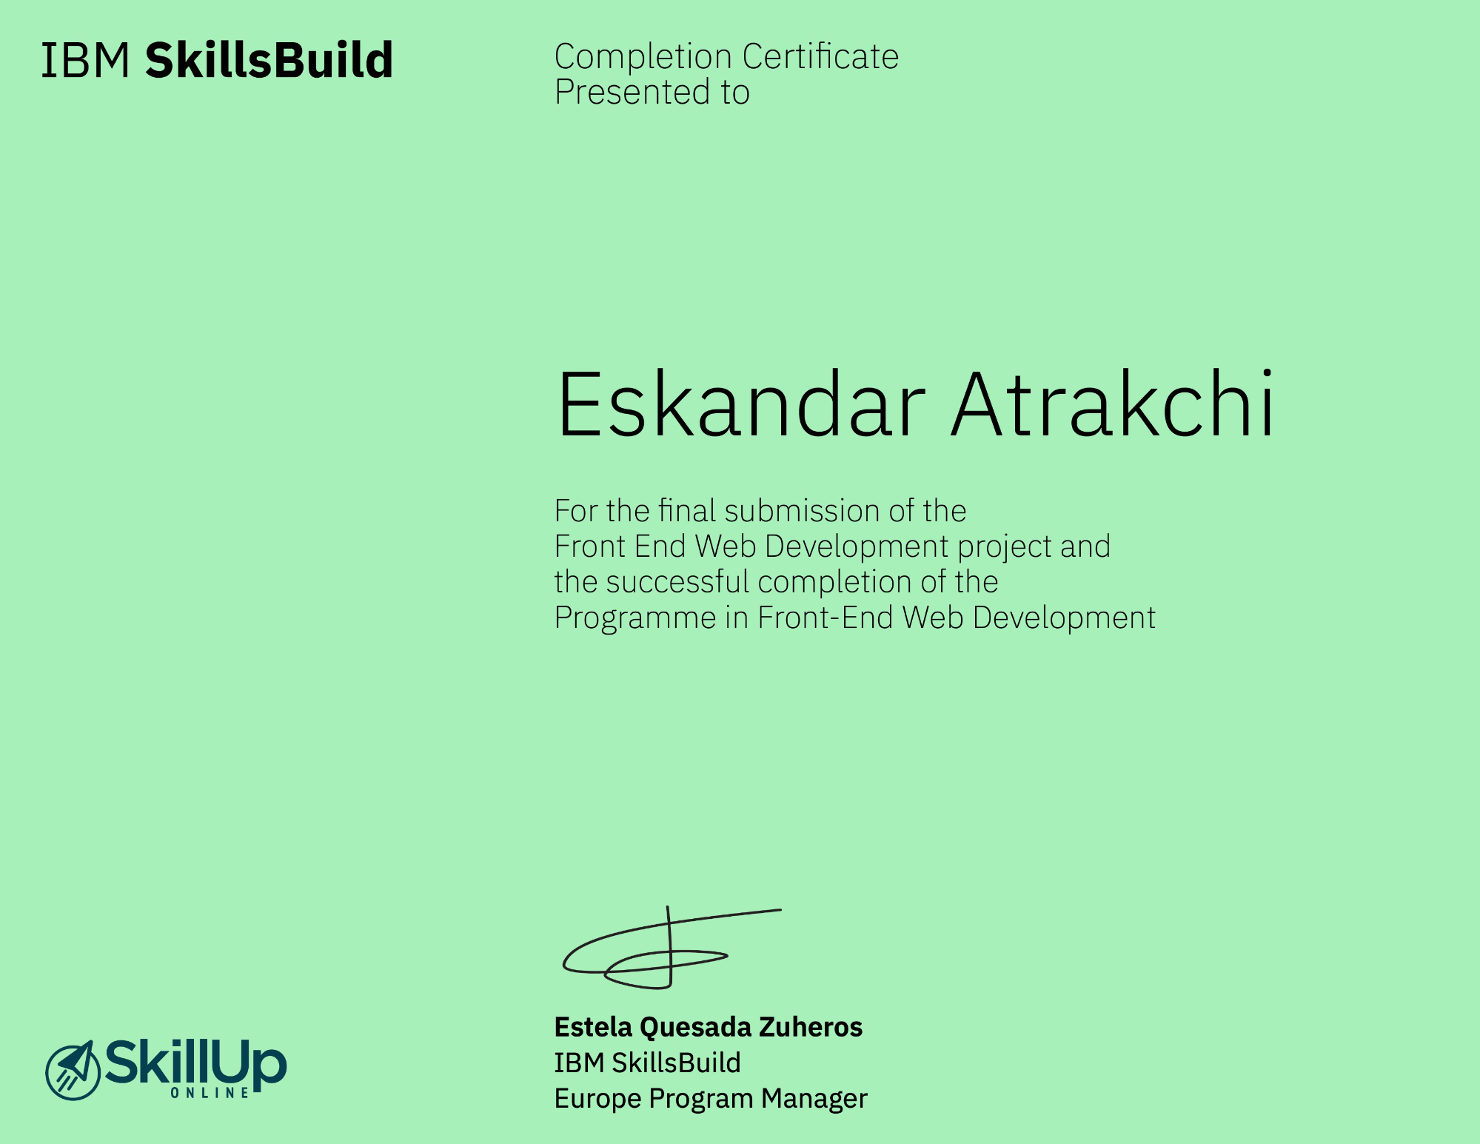

Slide 11
Any Questions?

